Slide 1


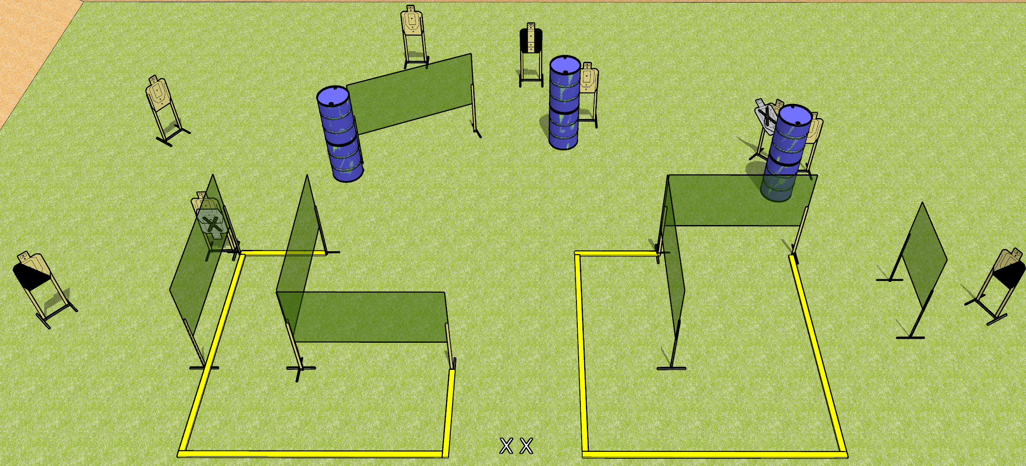
 | Dothan Gun Club – USPSA Match Box Me Up Course Designer : Drew Coleman
Round Count 27 rounds 9 USPSA targets
Equipment List 12 wall feet 4 medium fault lines 2 diagonal, 1 tuxedo

Slide 2
Box Me Up
Written Stage Briefing
Box Me Up is a 27 round, 135 point, Comstock course of fire. There are 9 USPSA targets. The best 3 hits on paper will score. The start signal is audible.
Handgun start position is both feet on X’s, wrists below belt. Handgun is unloaded and holstered.
PCC start position is both feet on X’s, stock on belt. Unloaded carbine is held with both hands.
On start signal, engage targets as they become available from within the shooting area.

